Slide 1


Bachelor of Science in Exercise Physiology
Valdosta State University
College of Nursing and Health Sciences
Fall 2023 Cohort
Follow Us on Instagram: vsu_ep

Slide 2
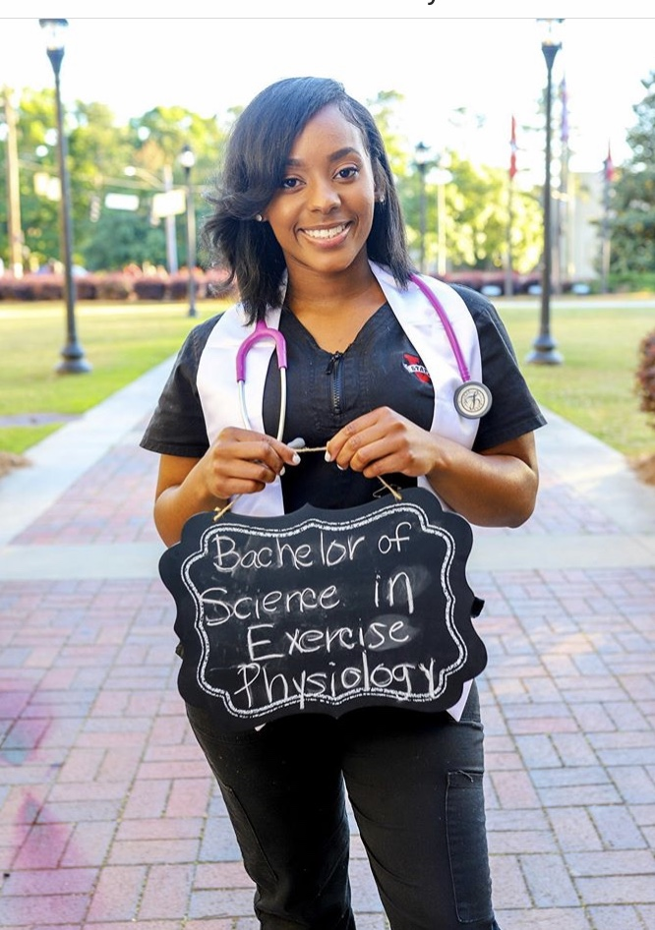
Table of Contents
Our Exercise Physiology Family
VSU Exercise Physiology Opportunities and Experiences
VSU Exercise Physiology Degree Program
Polices and Procedures
Tips for Success
Jackera Duncan
B.S. EP August 2019

Slide 3
Purpose
Welcome
Exercise Physiology degree
Opportunities and Experiences Outside of the Formal Classroom Setting
Policy and Procedures
Tips for Success
Faculty & Staff
Why Important
Another 2-yr Investment
Expectations as a Student
Important milestones, deadlines, financial costs, decisions
Opportunities to make your experience with EP more meaningful
We want you to succeed and to be successful

Slide 4
Section I – Our Exercise Physiology Family

Slide 5
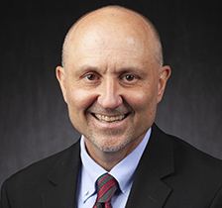
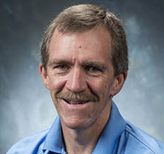
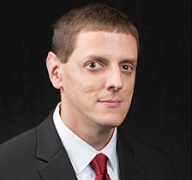
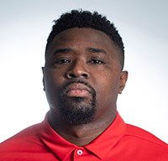
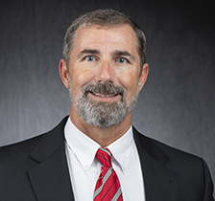
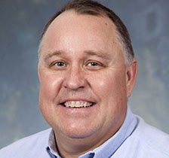
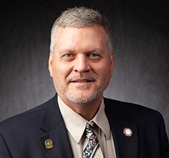
Exercise Physiology Faculty
Mark J. Kasper, EdD
Mike Webster, PhD
Brian Williams, MS
Lonnie Maddox, MS
Chuck Conner, EdD
Russ Hoff, MS
LaGary Carter, DA

Slide 6


Center for Exercise Medicine and Rehabilitation
TBD
Exercise Physiologist
Paul Higgs, MS
Athletic Trainer

Slide 7
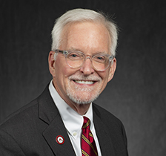
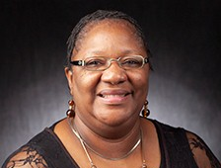
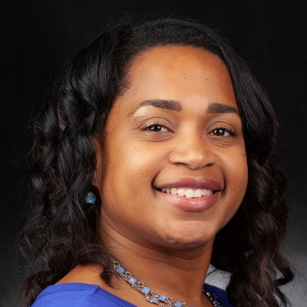
Administration and Support Staff
James Pace, PhD, Dean
LaGary Carter, DA
Associate Dean
Sebrina Solomon
Administrative Coordinator
Michelle Carter
Clinical Experience Coordinator

Slide 8
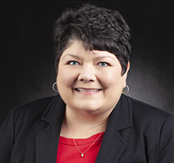
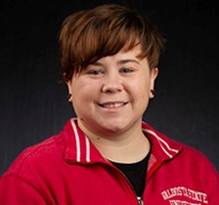
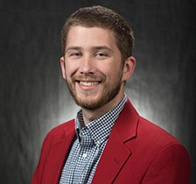

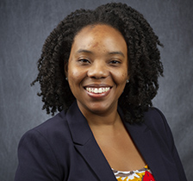
Advising Center - College of Nursing and Health Sciences
2nd floor of the Health Science Building email: conhsadvising@valdosta.edu
Karen Higgs
Director of Advising
Ashton Young
Academic Advisor
Nick Harrison
Academic Advisor
Jake Martin
Academic Advisor
Instructional Technology Specialist
Rafiah Jenkins

Slide 9
VSU Assistance Programs
Access Office
www.valdosta.edu/access
Located in Farber Hall
The mission of the Access Office is to create an accessible, inclusive, sustainable learning environment, in which disability is recognized as an aspect of diversity that is integral to the campus community and to society. Some examples of the services available to eliminate barriers include classroom and testing accommodations, materials in alternate formats, and access to adaptive technology.
Counseling Center, Mental Health, Alcohol and Other Drug Education
https://www.valdosta.edu/student/student-services/counseling-center/
Located in Student Health Center
The Counseling Center provides a broad range of mental health services to the university community aimed at maximizing the personal growth and development of its members. These services are free of charge. 24 hour emergency help is also available through the University Police at 229-259-5555 who will contact on-call counselors or appropriate resources for support
Office of Alcohol and Other Drug Education is dedicated to taking a pro-active approach in addressing the issue of substance use/abuse among the VSU community and its potential impact on academic, professional, and social development.
Student Health Center
https://www.valdosta.edu/administration/finance-admin/auxiliary-services/student-health/
Located on Georgia Avenue
The Student Health Center is a department within the Division of Auxiliary
Services. Services are available to all currently enrolled full-time students who
are taking four, or more, semester hours and who have paid the health fee.

Slide 10
VSU Assistance Programs - continued
Academic Support Center
https://www.valdosta.edu/asc/
The Academic Support Center (ASC), located in Odum Library, 2nd floor, provides free academic assistance through its Peer Alliance Learning (PAL) program. A PAL is a peer who helps another in a subject area for mutual benefit. A PAL Ally (formerly Tutor) works one-on-one with other students. A PAL Facilitator (Formerly SI Leader, Embedded Tutor, Recitation Leader) is attached to a course and facilitates learning in groups. Either way, the learning sessions work best if you come prepared with drafts, homework, textbooks, or problem sets. The PAL then models ways to solve problems, but the work is yours! The ASC also offers success workshops. Call 229-333-7570 for information, email us at asc@valdosta.edu, or visit our website: www.valdosta.edu/asc.
Office of Social Equity
https://www.valdosta.edu/administration/social-equity/
Valdosta State University (VSU) is committed to creating a diverse and inclusive work and learning environment free from discrimination and harassment. VSU is dedicated to creating an environment where all campus community members feel valued, respected, and included. Valdosta State University prohibits discrimination on the basis of race, color, ethnicity, national origin, sex (including sexual harassment and sexual violence), sexual orientation, gender identity, religion, age, disability, genetic information, or veteran status, in the University's programs and activities as required by applicable laws and regulations such as Title IX. The individual designated with responsibility for
coordination of compliance efforts and receipt of inquiries concerning
nondiscrimination policies is the University's Title IX Coordinator: the Director
of the Office of Social Equity, titleix@valdosta.edu, 1208 N. Patterson St., Valdosta State University, Valdosta, Georgia 31698, 229-333-5463.

Slide 11
Academic Support Center Workshops
Offered Each Term
https://www.valdosta.edu/asc/
Workshops include -
Academic Goal Setting and Role Management
Coping in College
Partnering with Faculty
Active Listening, Note Taking, and Participation
Critical and Creative Thinking
Personal Finance
Phone: 229-333-7570
Fax: 229-333-7579
E-mail: asc@valdosta.edu
2nd Floor Odum Library

Slide 12
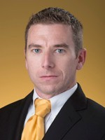
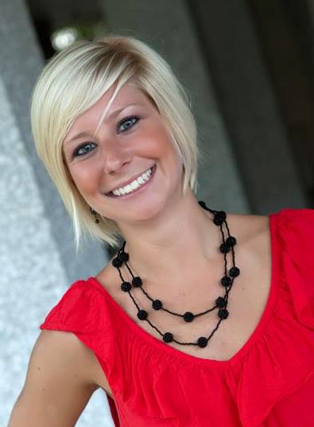
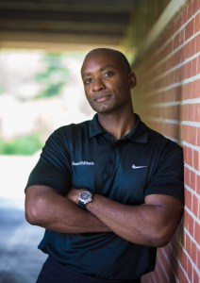
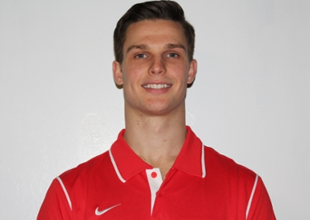
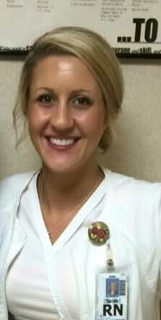
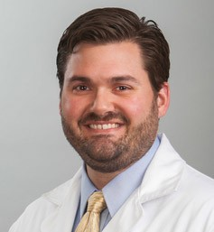
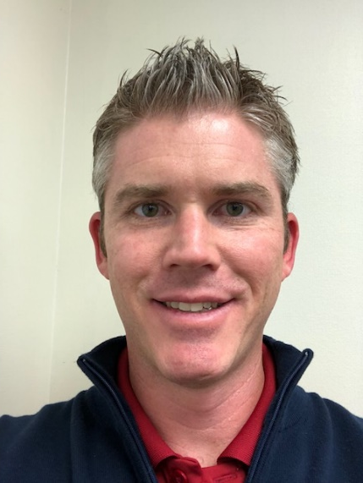
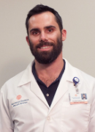

Austin Grant
Training Director,
Edge Performance
Bradford Bailey
Founder, Senior Fit Atlanta
Jeremy Gough
Director, Strength & Conditioning
The Walker School
Erin (Williams) McDill
Health Coaching
CareATC, Inc
Over 600 VSU Exercise Physiology Alumni
Amanda (Martin) Moore
Physical Therapist
Co-owner, Southerland Physical Therapy
Brent Wilson
Physician Assistant
Tallahassee Orthopedic Clinic
Sarah Nebel
Nurse Practitioner
Bart Edgar, Manager
Ergonomics and Occupational
Health Testing, CSX Railroad
Jasmine Jackson
Public Health PhD
Student, Southern IL Univ
Caleb F. Powell
Emergency Medicine

Slide 13

For those interested in Physical Therapy
The #1 major for those accepted into PT school – 52% - earned a BS in Exercise Physiology. The next highest degree was 10%. (APTA 2020)
VSU BS Ex Phys – it’s where you need to be!

Slide 14
Section I – Take Home - Our Exercise Physiology and College of Nursing and Health Sciences Family
Valdosta State University has quality faculty and staff with numerous supportive programs to promote student success
You are now part of the Exercise Physiology family!
Welcome

Slide 15
Section II – VSU Exercise Physiology Opportunities and Experiences

Slide 16
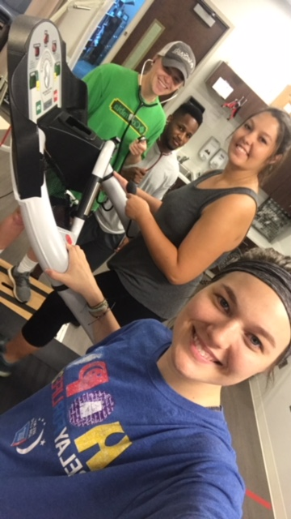
Exercise Physiology students have numerous opportunities to apply their education in clinical and non-clinical settings. They have access to a Human Performance Lab that houses equipment to assess cardiopulmonary function, body composition, muscle strength, and other measures of human performance.
Halie Pearce Anfernee Powell Megan Westenfeld Hope Smith

Slide 17
Human Performance Laboratory
Must be supervised by an Exercise Physiology faculty member
No eating, no drinking, no tobacco, no gum
Comply with the dress code
  Athletic shoes (no sandals, flip flops, dress shoes, etc)
  Athletic shorts or athletic pants (no jeans, belts)
  T-shirt with sleeves (preferable short sleeves)
  No ball caps or hats
Equipment –
  not a “drop zone” for your belongings
  not a chair
  not a toy
  not a playground
If equipment is not operational please inform an EP faculty member
Don’t operate with the equipment if you have yet to be trained on such equipment
Brian Williams
Director, HPL
Many of the HPL policy and procedures falls under OSHA safety standards

Slide 18
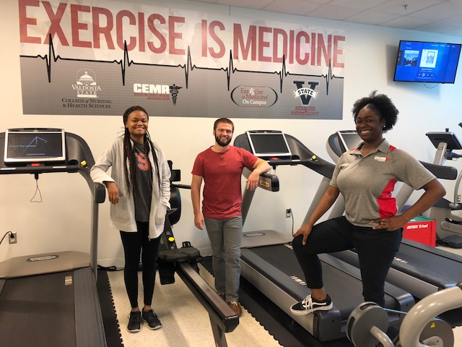
Exercise Physiology students have numerous opportunities to apply their education in clinical and non-clinical settings. Students can gain extensive hands-on experience by working and learning in VSU’s Center for Exercise Medicine and Rehabilitation
https://www.valdosta.edu/colleges/nursing-and-health-sciences/cemr/
Jasmine McNair Kaleb Noviello Breanna Trueblood
July 24, 2018 Valdosta State University CEMR

Slide 19

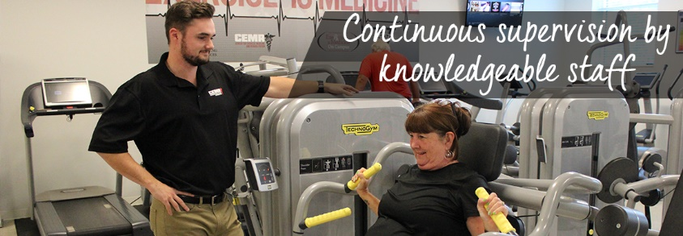
Center for Exercise Medicine and Rehabilitation
https://www.valdosta.edu/colleges/nursing-and-health-sciences/cemr/
TBD
Director, Exercise Physiology
CEMR
Your Face Here
CEMR Hires EP Students
Mission. To educate and train students while fostering an avenue for faculty practice and supervision through the delivery of select primary, secondary and tertiary services for students and employees of VSU, local municipalities, industry and citizenry

Slide 20
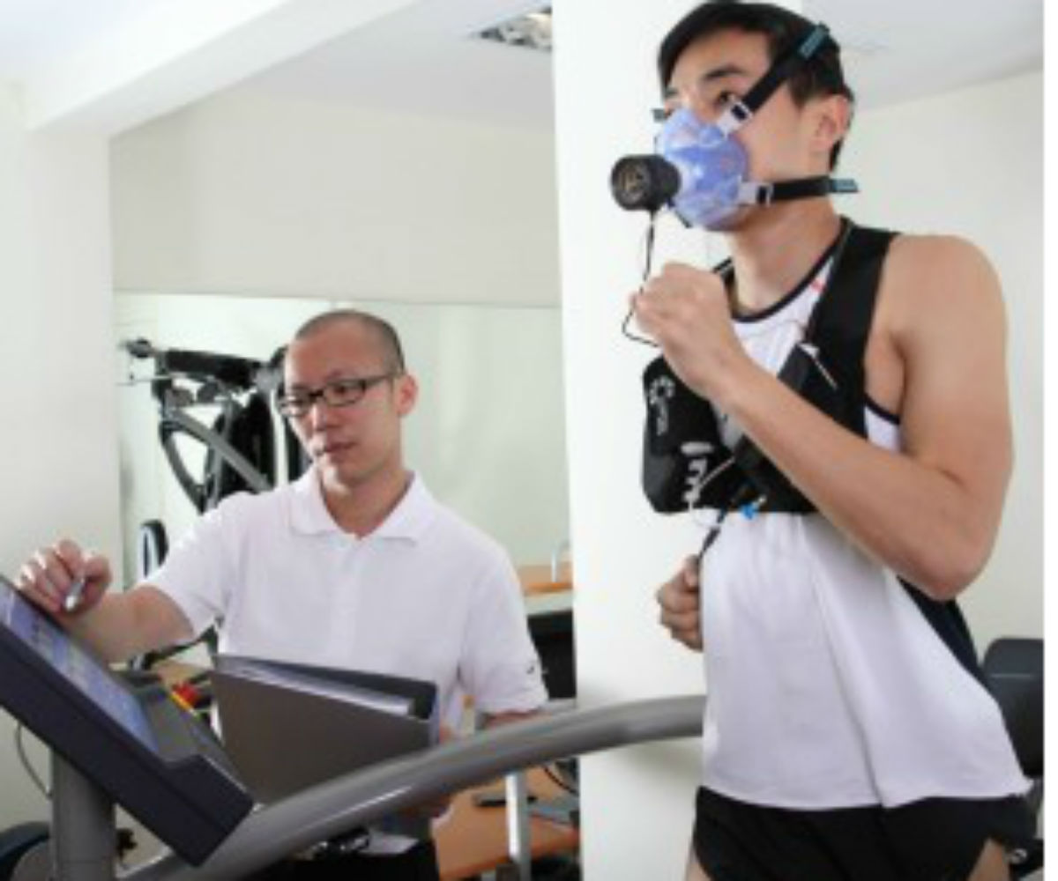
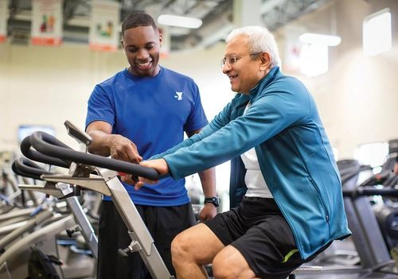
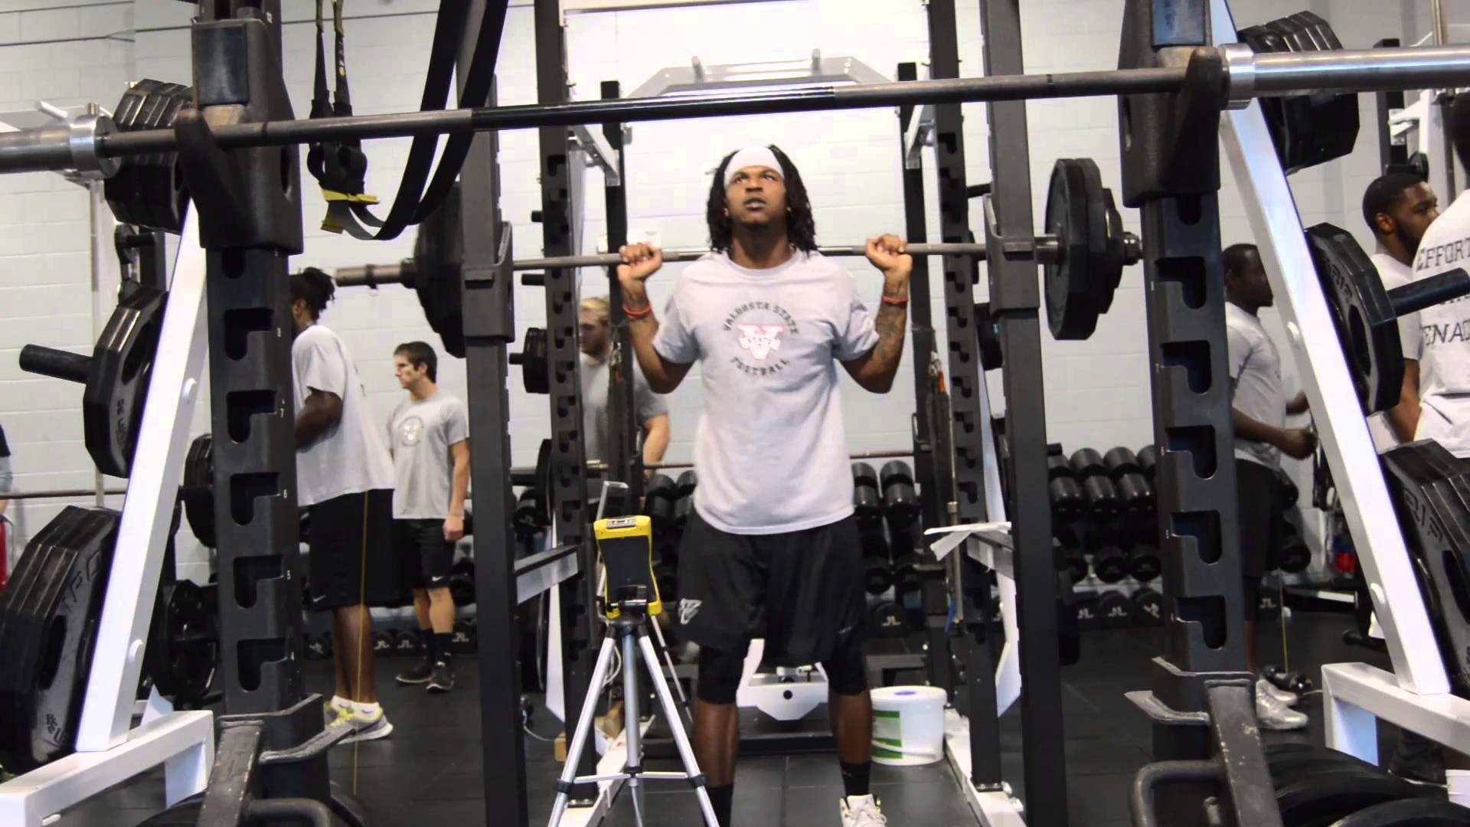
Exercise Physiology Internship
Comprehensive, hands-on practical and technical experience in delivering exercise physiology services
40 hrs per week for a minimum of 10 weeks = 400 cumulative hours
Local, regional, state, national, international
Over 100 existing affiliation agreements
Site that best fits the desires and goals of the student
“I wish I could hire Lucy”
“Charlie was more of an experienced professional than a student intern”
“Send us more VSU exercise physiology students”

Slide 21
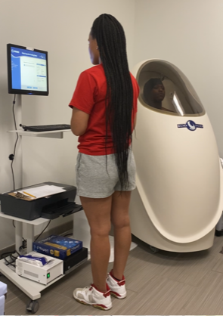
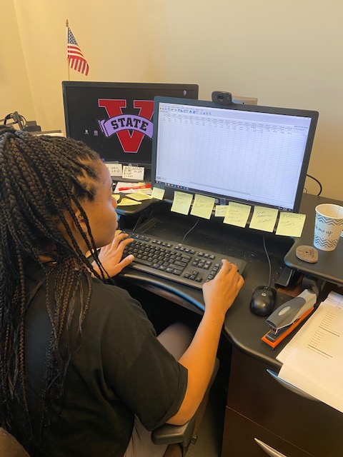

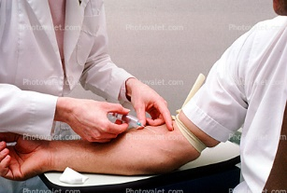
Research Opportunities
Side-by-Side Research Mentoring
Literature Review
Research Design and Methods
Institutional Review Board Application
Subject Recruitment
Data Collection
Data Analysis
Manuscript Writing and Submission
Professional Presentation
Research experiences are often preferred qualifications for graduate level work including those in PT, PA, MD and Exercise Physiology

Slide 22





Exercise is Medicine on Campus
Calls upon universities and colleges to promote physical activity as a vital sign of health
EIMOC encourages faculty, staff and students to work together toward improving the health and well-being of the campus community by:
Making movement a part of the daily campus culture
Assessing physical activity at every student health visit
Providing students with the tools necessary to strengthen healthy physical activity habits that can last a lifetime
Connecting university health care providers with university health fitness specialists to provide a referral system for exercise prescription
Mark Kasper
Faculty Liaison
EIM on Campus
Body Temperature * Pulse Rate * Respiration Rate * Blood Pressure * Physical Activity

Slide 23


Professional Conferences
SEACSM – Southeast American College of Sports Medicine
Annual Meeting is held in February of each year
SEACSM exchanges “volunteer help” at the meeting for registration
http://www.seacsm.org/
Mike Webster

Slide 24
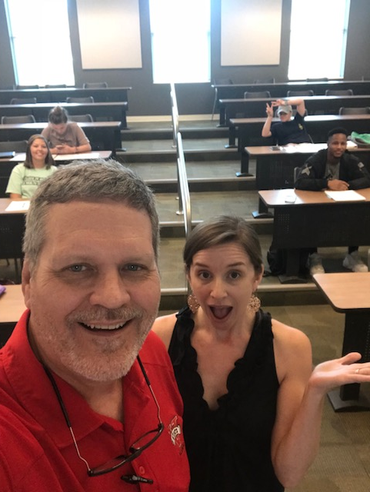
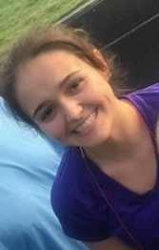
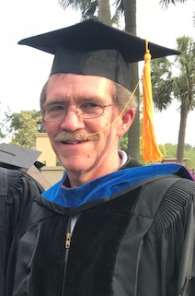
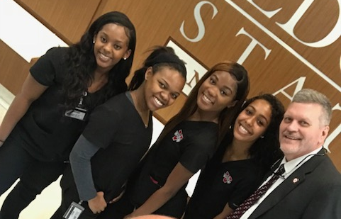
B.S. Exercise Physiology Educational Opportunities
Scientific Research with Faulty
Exercise is Medicine on Campus
Professional Conferences
Center for Exercise and Medicine
Human Performance Laboratory
Practical Internship Experience
Classroom Learning

Slide 25

Opportunities Outside the Classroom
Better academically
Better connection with professors
Overall better experience w/ school
We Challenge You to
Get out of your comfort zone
Get in the arena
Take advantage of what is available

Slide 26
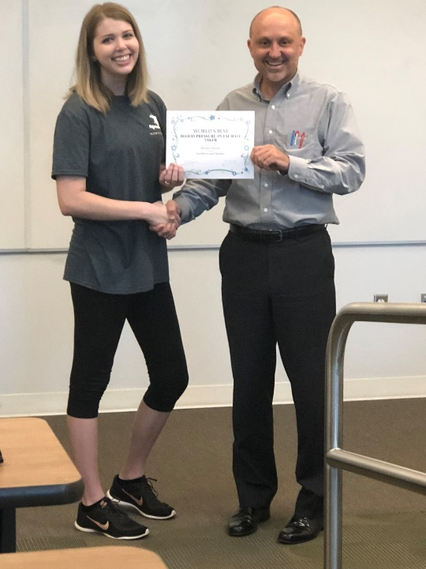
Section II – Take Home - VSU Exercise Physiology Opportunities and Experiences
The B.S. in Exercise Physiology at Valdosta State University
Combines classroom teaching with hands on experiences including those in the laboratory, the fitness center, conducing research with faculty, and an internship
Provides opportunities for students to interact socially and professionally with other exercise professionals and health care providers
B.S. Exercise Physiology Educational Opportunities
Scientific Research with Faulty
Exercise is Medicine on Campus
Professional Conferences
Center for Exercise and Medicine
Human Performance Teaching Laboratory
Practical Internship Experience
Classroom Learning
Find YOUR Greatness in EP
Start YOUR Career in EP

Slide 27
Section III – VSU Exercise Physiology Degree Program

Slide 28




Goal: To educate and train students through a structured, innovative and engaged learning construct to become a credentialed Exercise Physiologist
https://www.valdosta.edu/programs/bachelor-of-science-in-exercise-physiology-degree/
1994
Job Task Analysis
Knowledge, Skills and Abilities
present
VSU graduates have always been academically prepared to enter the profession

Slide 29

The Exercise Physiology program is accredited by the Commission on Accreditation of Allied Health Education Programs (CAAHEP) through the Committee on Accreditation for the Exercise Sciences (CoAES)
Less than 80 accredited programs in the USA – only 9 is the SE region
VSU was the first CAAHEP accredited university in the State of GA
Employers want professionals who can take the science and apply it to exercising adults in a variety of settings. CAAHEP accreditation assures students and employers that graduates from Valdosta State University have the knowledge, skills, and abilities to enter the workforce as exercise physiologists.

Slide 30

Calendar Year | VSU Candidates | VSU Passed | VSU Pass Rate | National Pass Rate
2018 | 27 | 25 | 93% | 71%
2019 | 51 | 47 | 92% | 72%
2020 | 2 | 2 | 100% | 78%
2021 | 16 | 15 | 94% | 78%
Total | 96 | 89 | 93%
VSU BSEP earned CAAHEP accreditation in July 2015

Slide 31
Expected Student Learning Outcomes and Assessments – VSU Catalog
http://catalog.valdosta.edu/undergraduate/academic-programs/nursing-health-sciences/bs-exercise-physiology/
Selected Educational Outcomes
Knowledge in basic functional anatomy, biomechanics, electrocardiography, and physiological responses to exercise.
Knowledge of nutrition and body composition as related to exercise performance and health maintenance.
Knowledge of electrocardiography, submaximal and maximal exercise testing procedures, and techniques related to health and fitness assessments.
Administrative and leadership skills for exercise programs in a variety of clinical and non-clinical settings.
Knowledge of assessment, evaluation, and education of various populations in clinical and non-clinical settings regarding physical activity and healthy lifestyles.
Knowledge of training theory and methods for developing physical abilities as they relate to athletic performance.
Examples of Outcome Assessments
Develop, through written, oral, and practical examinations, a scientifically based and medically safe fitness assessment and exercise prescription
Interpret successfully, through written, oral, and practical examinations, the results of health and fitness assessments and demonstrate proficiency in exercise and nutrition prescription for an individualized program for exercise performance and health maintenance
Demonstrate applied competency in electrocardiography interpretation, submaximal and maximal exercise testing, which includes gas analysis, body composition analysis techniques, risk stratification utilizing health and fitness assessments, and various other tests to determine aerobic and anaerobic capacity
Through written, oral and practical examinations describe the prncipals underlying the development of hypertrophy, strength, power, speed, agility and anaerobic capacity for athletic performance

Slide 32
Broadly – these are Selected Expectations for the BSEP Degree
Prescribe exercise, basic health behavior interventions and promote physical activity for individuals with chronic diseases or conditions; examples include, but are not limited to, individuals with cardiovascular, pulmonary, metabolic, orthopedic, musculoskeletal, neuromuscular, neoplastic, immunologic and hematologic diseases.
Prescribe exercise designed to improve, maintain or attenuate declines in fitness and health in populations ranging from children to older adults.
Provide exercise screening, exercise and fitness testing, exercise prescriptions, exercise and physical activity counseling, exercise supervision, exercise and health education/promotion, and measurement and evaluation of exercise and physical activity-related outcome measures.
Develop and assess physical abilities as they relate to athletic performance
Knowledge of movement preparation, resistance training technique, Olympic weight lifting and plyometric exercise, speed/sprint technique, agility technique, energy system development, and recovery techniques in the athletic population
Be guided by published professional guidelines and standards and applicable state and federal laws and regulations.
Adopted from ACSM and NSCA Certification Website

Slide 33
Specifically – these are the Job Tasks and Competencies – Standards
Job Tasks – ACSM Certified Exercise Physiologist
http://www.acsm.org/docs/default-source/certification-documents/acsm-ep_jta_-full-(2017)-final-(1)85eeee5bc28a45b3a4d78b1881a4e4ab.pdf?sfvrsn=f6a7a41_2
The BSEP degree addresses all of these competencies
Job Tasks – ACSM Certified Clinical Exercise Physiologist
http://www.acsm.org/docs/default-source/default-document-library/get-stay-certified/exam-content-outlines/acsm-certified-clinical-exercise-physiologist-exam-content-outline.pdf?sfvrsn=71f3471a_2
The BSEP degree addresses MOST of these competencies
BSEP Curriculum includes MOST of the following areas of instruction – NCSA Certified Strength and Conditioning Specialist
Human anatomy and physiology, Exercise physiology, Kinesiology/Biomechanics, Sports Nutrition, Psychology of Sport and Exercise, Scientific Principles of Strength and Conditioning, Resistance Training and Conditioning Practical/Laboratory, Exercise Testing/Exercise Rx with Emphasis on Anaerobic Exercise, Program Design for
Strength and Conditioning, Plyometric Training, Speed and Agility Training,
Aerobic Training, Program Organization, Administration and Oversight

Slide 34
Professional Course Requirements – 60 hrs
http://catalog.valdosta.edu/undergraduate/academic-programs/nursing-health-sciences/bs-exercise-physiology/
Professional Course Requirements (60 Hours)
First Block (Fall and Spring)
HSEP 3010 Exercise Testing and Prescription I 3 hours
HSEP 3020 Fitness & Performance Testing in Ex Phys 4 hours
HSEP 3420 Exercise Physiology 3 hours
HSEP 3430 Structural Kinesiology 3 hours
HSEP 4160 Exercise Psychology 3 hours
Second Block (Spring and Summer)
HSEP 3011 Exercise Testing and Prescription II 3 hours
HSEP 3200 Nutrition for Health and Human Performance 3 hours
HSEP 3650 Applied Exercise Musculoskeletal Interventions 3 hours
HSEP 4070 Exercise Cardiopulmonary Physiology 3 hours
HSEP 4080 Exercise Electrocardiography 3 hours
Third Block (Summer and Fall)
HSEP 3050 Prevention of Exercise-Related Injuries 3 hours
HSEP 4050 Strength & Conditioning Athletic Performance 4 hours
HSEP 4140 Professional Practices in Exercise Physiology 3 hours
HSEP 4210 Clinical Exercise Physiology 3 hours
HSEP 4510 Exercise Physiology Practicum 4 hours
Fourth Block (Fall, Spring and Summer)
HSEP 4550 Exercise Physiology Internship 12 hours
Any deviation - including earning a grade lower than a C in any course - may result in delay of graduation
No mechanism is in place nor will one be made for getting “back on track”
Any deviations ought to be discussed with the Program Director prior to deviating

Slide 35
BSEP – Program Progression and Retention
Once admitted into the program, classes are taken in blocks, 1 through 4, in sequence.
Students must maintain a "C" or better in all upper-level HSEP courses.
Students who receive three "D," "F," or "WF" grades in upper-level HSEP courses will be dismissed from the program.
To be eligible for any third block courses, students must have earned a "C" or better in all first and second block courses. An exception to the third block policy is having to repeat just one second block course.
To be eligible for HSEP 4510 Practicum, students must have a returned graduation application from the Registrar and be currently enrolled in all remaining courses required for graduation excluding HSEP 4550 Internship.
To be eligible for the fourth block internship (HSEP 4550), students must have a "C" or better in all third block courses and meet all other prerequisites for the course.

Slide 36
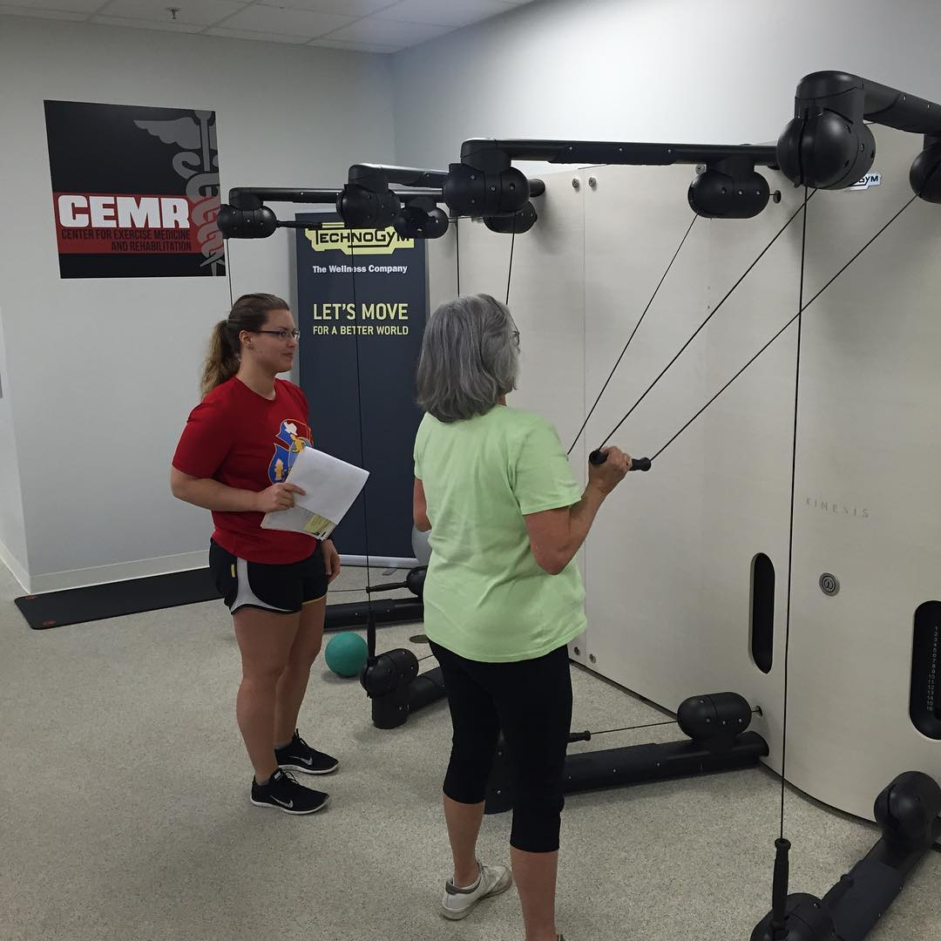
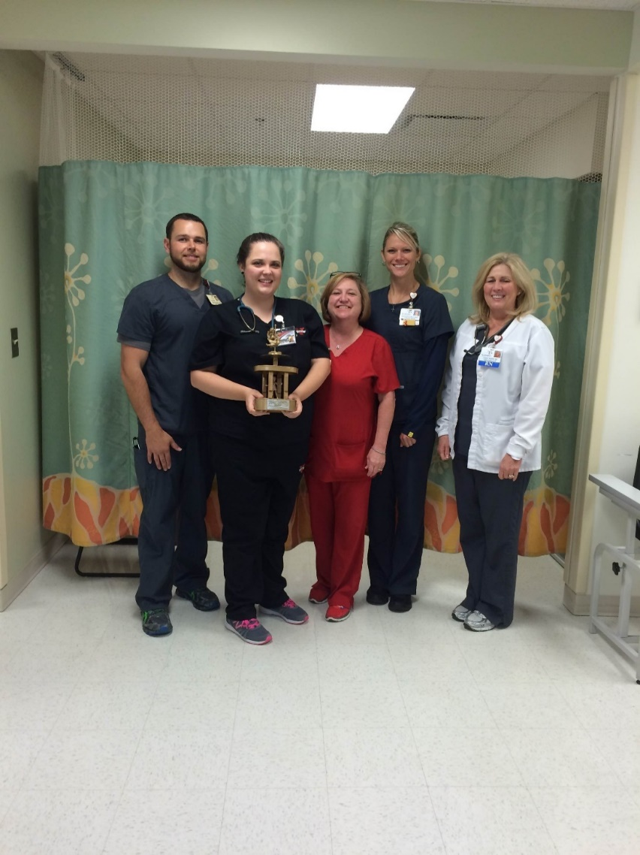
HSEP 4550 Internship
Provides student with practical hands-on experience in the field of clinical or applied exercise physiology
40 hours per week for a minimum of 10 weeks = 400 cumulative hrs
Must take ACSM EP or NSCA S & C certification examination
* Must have grade of “C” or better in all course requirements in order to register / take HSPE 4550 Internship
Brian Williams
Internship Coordinator
Site Eligibility
Internship site must reflect an area directly related to the field of clinical or applied exercise physiology
A list of the current contract internship sites can be found on the BS EP website
- The approval of a site not identified with a current MOU takes time and ought be done at least two semesters before you intern

Slide 37
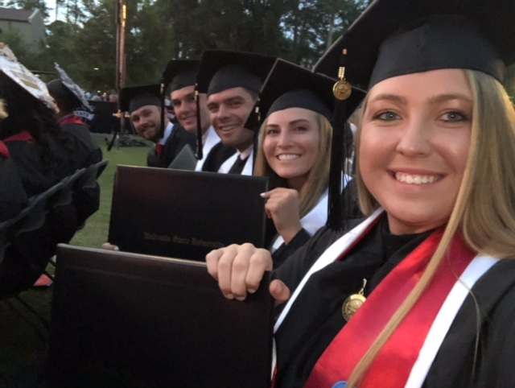
General Exercise Physiology Graduation Requirements
General Graduation Requirements
Completion of all Block 1-4 courses with a “C” or better including HSEP 4550 Internship
Overall cumulative GPA of greater than or equal to 2.00
James Ethredge Daniel Tefft David Wright Tara Dambach Caitlyn Dawkins
Valdosta State University - Spring Commencement - May 5, 2018

Slide 38
Tuition, Fees and Costs of the Program – Including Internship
University tuition, fees, and costs for coursework can be found in the Student Financial Services website
Additional approximate costs associated with BSEP - subject to change without prior notice
Program Requirements
Laboratory materials (HSEP 3010, 3020, 3050, 4510) ~$50 - $150
ACSM or NSCA Certification Exam ~$250 (ACSM) - $350 (NSCA)
HSEP 4550 Internship Requirements
Student Professional Liability Insurance ~$85 - $100
Criminal Background Check and 10 Panel Drug Screen ~$125 - $150
ACSM student or affiliate membership ~$20 / year
American Heart Association BLS for Healthcare Providers ~$50
Health Insurance variable
Physical Examination and Vaccinations variable
Other
Laptop computer with web camera for computer based classroom or virtual exams
Textbook / Technology cost: dependent on course textbook requirements and technology resource costs
Travel to educational experience sites as warranted (most sites are in Lowndes County or within a 50 mile radius)
Miscellaneous clothing cost: dress shirts, dress pants, coat, tie, dresses, dress shoes –
required for certain aspects of the program (i.e. dress attire for student presentations,
guest speakers, conferences, interviews, etc)
Tuition/Housing/Meals/etc.: dependent on individual student options
https://www.valdosta.edu/administration/finance-admin/financial-services/students/
~ $1,000
Several
Hundred $$$$

Slide 39

Laptop – Classroom Computer Based Exams
Classroom and virtual exams and quizzes may be computer based
Each student must have their own laptop
Must have a web camera on the laptop
Odum library has free checkout service
Odum library has a computer room with computers for taking virtual exams
Must have adequate RAM and processor speed
Tablets, chromebook, smart phones, etc will not be able to handle VSU computer based exams
The operating system needed is one of the following:
  Windows 10, 8, 7
  MACOS 10.14 to 10.12 OS x 10.11, OSX 10.10

Slide 40
Academic Advising – “Flag” lifted and Application for Graduation
https://www.valdosta.edu/academics/academic-affairs/advising/application-for-graduation.php
Must see your advisor prior to registering for courses – “lift flag”
By mid-term of 2nd block – see your advisor – “Apply for Graduation”
  Application must be returned from the registrar by the start of 3rd block
  Any course deficiencies can / must be rectified during 3rd block to ensure 4th block internship and “on-time” graduation
See your advisor – any faculty member – to chat about anything including career paths, graduate school, current coursework, your best 5K time …

Slide 41
Section III – Take Home - VSU Exercise Physiology Degree Program
CAAHEP accreditation verifies to employers, other schools of higher learning, and the public that the curriculum is meeting rigorous standards.
Must earn C’s or higher in all BSEP Jr/Sr coursework.
Courses are taken in blocks in sequence
Talk to you advisor and professors on a frequent basis – to discuss progression through the degree – as well as mentoring for future career paths.
During 2nd block you’ll need to start preparing for 4th block Internship.
Plan on needing additional financial resources beyond tuition and fees – that are specific to BSEP.

Slide 42
Section IV – Policies and Procedures

Slide 43
Policies, Rules, and Expectations in Academic Courses – part 1 of 2
Each student is responsible for knowing the specific attendance, participation and tardiness requirements for each course. Have your professors’ email and office phone in your cell phone contacts.
When a student is compelled for any reason to be absent for or unable to participate in class, they should immediately contact the instructor.
Classes start “on-time” as per the course time posted on the university schedule of classes. Be aware of the specific tardy policy for each course for each instructor. The instructor will start class “on time” - not wait until students arrive to begin class. If a student arrives “late” they should enter the classroom as quietly as possible and take the first seat closest to the door as to not interrupt the class.
Each student is responsible for knowing specific dress code requirements for specific courses or specific classes within a course – and the penalty for non-compliance. For example, when there is a lab, students will have to come dressed appropriately – which typically means a short sleeve t-shirt or tank top, athletic shorts (not jeans or pants), athletic shoes (not flip flops, sandals, shoes, boots).
Exams, quizzes, labs, homework, and assignments are taken and due at the assigned due date and time. Late assignments will not be accepted. Students who do not show or show late for examinations/quizzes will not allowed to sit for such evaluation. One is considered absent from an exam/quiz once the first student turns in their exam/quiz (paper) or once the computer time frame to start the exam is closed. Exams/quizzes and assignments cannot be made up. Exceptions may apply under very special circumstances (e.g., University sponsored activity) but will be dealt with on a one-on-one basis. A student must request before class to miss an evaluation. Otherwise, the absence will more than likely be unexcused. If an evaluation is to be made up, it must be made up before the start of the next class period.
The undergraduate catalog states that a student, whether/ online or face-to-face, who misses or does not participate in more than 20% of the scheduled course or course activities could be subject to receiving a failing grade in the course.
Each student is responsible for knowing the specific requirements regarding deadlines for evaluations including any disciplinary actions or penalties if deadlines are not met.

Slide 44
Policies, Rules, and Expectations in Academic Courses – part 2 of 2
Professors will not provide opportunities for extra credit, do-overs, optional work, additional work or the like in order to gain credit that would boost their grade.
All students should understand that vacations, early holiday departure or late holiday arrival, work-related issues, other academic classes or academic responsibilities are not valid excused reasons to miss class or assignments including evaluations.
Make up work or alternative assignments including quizzes and exams will be determined by the professor and at the sole discretion of the professor. These assignments may or may not exactly duplicate the original and will not entitle other students to the same alternatives since they may not have experienced the same situations. For example, if a student has a valid reason for missing an examination such make up examination may be in a different format such as essay rather than multiple choice.
When allowed for quizzes and exams, only a basic 4-function calculator is permissible. A 4-function calculator is one that only does the following 4-functions: addition, subtraction, multiplication, division. (They may also do square root and percentage).
Instructors will not supply pencils, calculators, scantrons, computers or paper for class lectures, quizzes, examinations or assignments. They are not required to provide course handouts.
If scantrons are used for testing purposes, students must supply their own scantrons.
Exams may be computer based. Each student must have their own laptop with a computer webcam-camera (Odum library has free checkout service) and with adequate RAM and processor speed. Tablets, chromebook, smart phones, etc will not be able to handle computer based exams. The operating system needed is one of the following: Windows 10, 8, 7 or MACOS 10.14 to 10.12 OS x 10.11, OSX 10.10.
Expect teachers to require that during exams and quizzes all belongings (hats, phones, drinks, backpacks, watches, earbuds, etc) be placed in the front of the classroom.
Recording of lectures or instruction (voice or video) including taking pictures of PPTs or material written on the white (chalk) board is prohibited without permission of the instructor. Information presented is the intellectual property of the instructor. Violations may result academic disciplinary action. Selling course notes is also prohibited.
Each student should know time lines for when course assignments are available for reviewing with the instructor. Typically, after one or two weeks after posting grades for an assignment material is no longer available for review.

Slide 45

Academic Honesty Policies and Procedures
https://www.valdosta.edu/academics/academic-affairs/academic-honesty-policies-and-procedures.php
Academic dishonesty will not (and has not been) tolerated by VSU or VSU EP
You are responsible for knowing and abiding by the VSU Academic Integrity Policy including Plagiarism
Academic Dishonesty may result in
  Grade of zero
  Grade of “F” for the course
  Expulsion or suspension from EP
  Expulsion or suspension for VSU

Slide 46


Confidentiality and HIPPA and PHI
Need to know
Violation of CONHS
Violation of Federal Law
May result in academic dismissal
Confidentiality Acknowledgment form
Signature required

Slide 47
Photo-Video-Model-Release Form
VSU EP often takes and uses pictures of our students for the following formats
Instagram: vsu_ep
VSU website
VSU media
Local / regional / national media
Other
This form is a VSU form that we need to have on file that basically says you allow us to use your photo in an appropriate manner.
We typically ask before we take such pictures and we will let you know where we, at least initially, plan to use them and for what purpose. So you can always “opt out” at that time if you do not desire to have your picture taken.

Slide 48
Technical Standards
Effective written and oral communication skills
Proficiency of the English language
Respect for diverse cultural backgrounds
Accuracy in recording medical information
Understanding and maintaining medical confidentiality
Strong problem solving skills
Critical or higher order thinking skills
Understand and accept constructive criticism
Emotional well-being
Ability to exercise sound judgment
Coping skills in stressful situations
Professionalism and rapport with diverse populations
Normal or sufficient auditory, visual and sensory perception
Minimum level of muscular strength and endurance based on national norms
Minimum level of cardiorespiratory fitness based on national norms
Ability to sit, stand, squat, kneel, push, pull, lift, hold and maintain balance
frequently and for prolonged periods of time
Or with reasonable accommodations
If appropriate, visit the VSU Access Office for Students with Disabilities

Slide 49
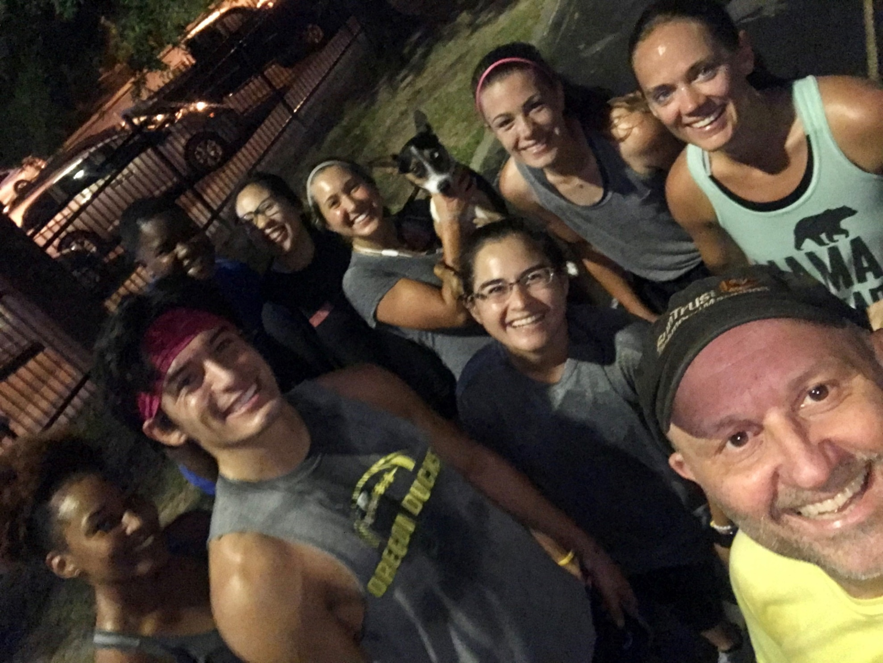
Be a Role Model
“Health professionals should personally engage in an active lifestyle to familiarize themselves with the issues involved in maintaining lifelong physical activity and to set a positive example for patients and the public.”
AHA Scientific Statement. Exercise and Physical Activity in the Prevention and Treatment of Atherosclerotic Cardiovascular Disease. Circulation. 2003; 107:3109-3116

Slide 50

Dress and Appearance
Anytime you are on campus
Anytime you are representing off-campus - VSU or VSU Exercise Physiology
Clothing, shoes, hair, facial hair, piercings, jewelry, tattoos, fingernails, dental hygiene, body odors …

Slide 51
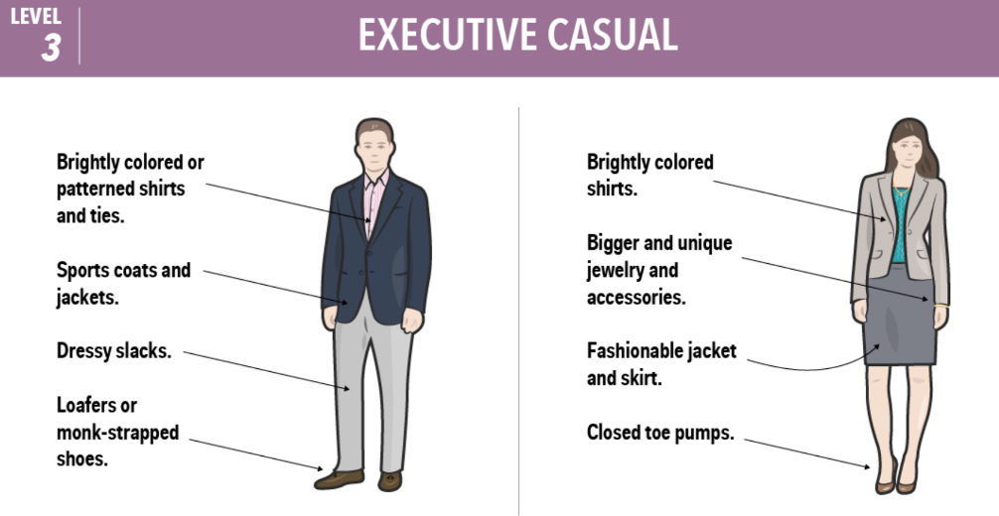
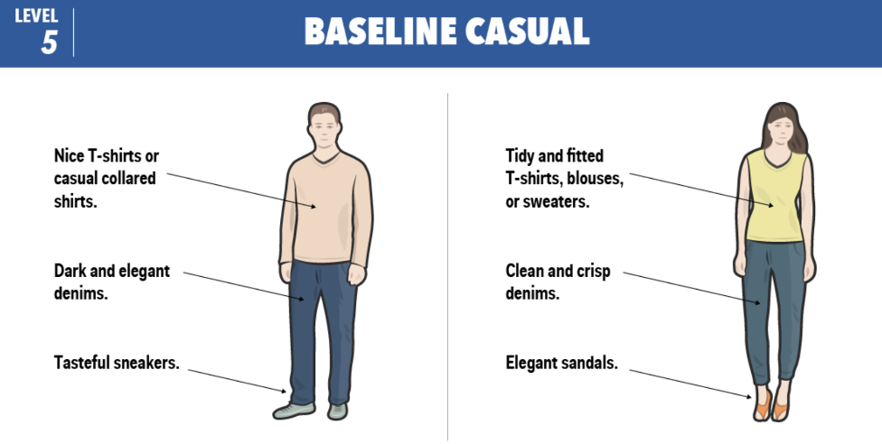

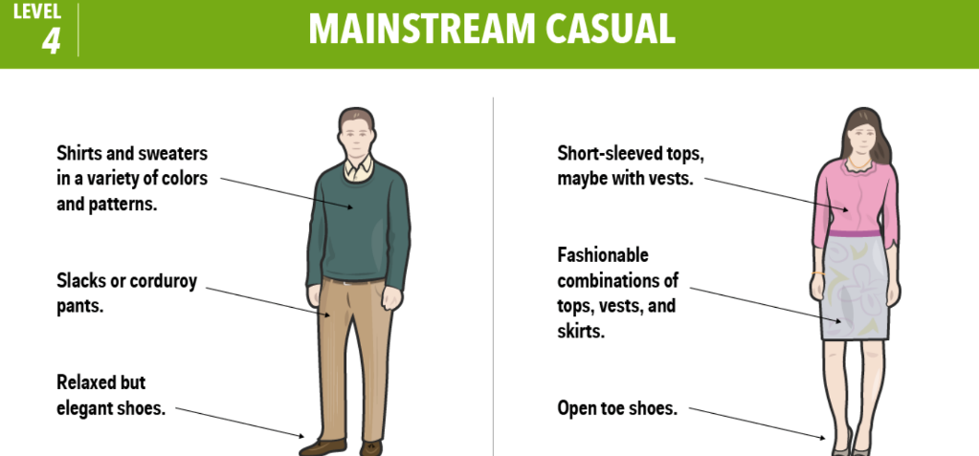
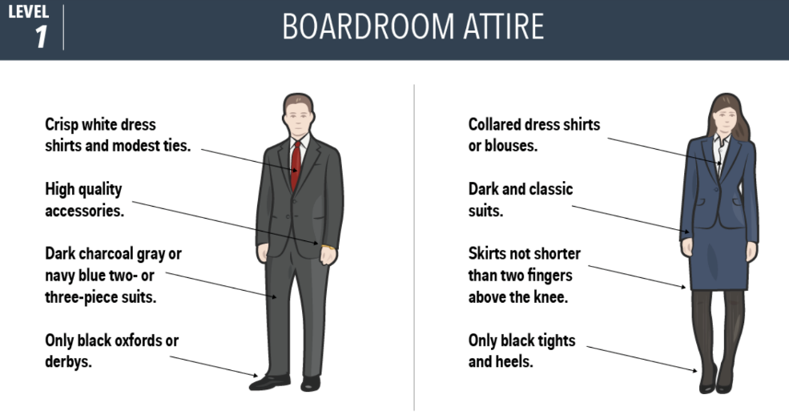
Stay clean and crisp, even when casual. Casual and sloppy are not the same thing. Hair, clothes, nails …
Just because you can doesn’t mean you should.
Ask yourself: is my outfit projecting the qualities to succeed in my profession as a _____________?
If you dress conservative, you’ll always be dressed appropriately – for any occasion.

Slide 52
Disposition Policy – College of Nursing and Health Sciences
https://www.valdosta.edu/colleges/nursing-and-health-sciences/documents/disposition-policy.pdf
The purpose of the Disposition Policy process is
For faculty to identify students who may need intervention to successfully complete both the pre-professional and professional requirements for their program of study
Dispositions are the values, qualities, and professional ethics that influence one’s behaviors toward students, families, colleagues and communities
Dispositions can affect student learning, motivation and development of personal and professional growth.

Slide 53
Disposition Policy – College of Nursing and Health Sciences - Continued
https://www.valdosta.edu/colleges/nursing-and-health-sciences/documents/disposition-policy.pdf
Examples of Actions Necessitating Completion of Disposition Forms - including, but not limited to -
Excessive absences or lateness for class or clinical assignments
Lack of professional dress or demeanor when interacting with other students, clients/patient, preceptors or faculty
Exhibiting disruptive behavior toward faculty, staff, preceptors, peer student or guest speakers. This includes classroom disruptive behavior. This extends to clients/patients and preceptors when students are in a clinical area affiliated with their program of study
Exhibiting a lack of proficiency and/or professionalism in written and/or oral language skills, including electronic forms of communications (i.e., e-mail, text, social media, etc.)
Demonstrating a lack of content/ clinical knowledge, including appropriate skill progression, in any content area at the student’s current level
Plagiarism or cheating on any graded activity
Blatant dishonesty or breach of confidentiality
Purposefully compromising the well-being of a client/patient
Harassment of clients, preceptors, peer students, faculty, or staff

Slide 54
Disposition Policy – College of Nursing and Health Sciences – Reporting Form
https://www.valdosta.edu/colleges/nursing-and-health-sciences/documents/disposition-policy.pdf
Procedures for Assessing Dispositions
A student’s professional dispositions will be assessed in classes, clinical, and community settings
The instructor or preceptor who identifies a deficiency or behavior inconsistent with established dispositions will follow these procedures
  Upon a student’s action which necessitates the completion of a disposition report, the instructor or preceptor will schedule an informal meeting. The purpose of the meeting with the student is to discuss the area of concern and offer possible solutions and remedies.
  The date of the meeting, the instructor’s specific concerns and potential solutions will be documented on the Disposition Report Form and placed in the student’s file
  Both instructor and student will receive a copy of the completed form.
  The faculty member involved in the informal meeting must complete either a VSU Student Conduct Incident Report or a VSU Academic Integrity Report if applicable
If a second meeting becomes necessary, based on the same deficiency or additional behaviors of concern there will be a meeting with the student that will include other parties (advisor, department chair/dean, program coordinator, etc)
  The result of this meeting may be a recommendation that the student
  be allowed to continue her/his program, development of a remediation
  plan, or a determination to remove the student from the program.

Slide 55
Academic Grievance
The School of Health Sciences encourages students to seek open discussion, and resolution, to grievance by applying the following procedure:
    The exercise physiology student with a problem is obligated first to seek a resolution to the problem with the involved faculty member
    If a satisfactory resolution cannot be reached, the student should submit a written request for review with supporting evidence to the Associate Dean of Health Sciences
    If a satisfactory resolution cannot be reached between the student and the Associate Dean, the student may appeal in writing to the Dean of the College of Nursing and Health Sciences
VSU Student Concerns and Complaints/Grievances including Process
https://www.valdosta.edu/academics/academic-affairs/concerns-complaints-grievances.php

Slide 56
Final Grade Appeals
https://www.valdosta.edu/academics/academic-affairs/grade-appeals.php
RATIONALE FOR GRADE APPEALS
Any student considering a grade appeal should understand that each faculty member has the right and responsibility to determine grades according to any method chosen by the faculty member as long as these methods follow professional and disciplinary standards, are clearly communicated to everyone in the class, and are equally applied to all students
Therefore, grades should only be appealed under circumstances such as the following:
  (a) The assignment of a grade to a particular student by application of more exacting requirements than were applied to other students in the course
  (b) The assignment of a grade to a particular student on some basis other than performance in the course
  (c) The assignment of a grade by a substantial departure from the instructor's previously announced standards
The grade appeal procedure is not to be used to review the judgment of an
instructor in assessing the quality of a student's work nor is it to be used if the
student disagrees with the instructor on how the course was conducted. Such
concerns should be shared with the instructor and/or the appropriate department
head.

Slide 57
Final Grade Appeals - Process
https://www.valdosta.edu/academics/academic-affairs/grade-appeals.php
Students who have just cause to appeal the assignment of a grade must first discuss the problem with their instructor
This process must begin within 30 working days after the registrar’s office has posted final grades for the term in which the course was taken
Further appeals are then directed, in order, to their instructor's Department Head, and Dean
Copies of the final course grade appeal policy, procedures, and form are available in the Office of the Registrar

Slide 58
Section IV – Take Home - Policies and Procedures
Policies and procedures establish boundaries for acceptable behavior and guidelines for best practices. They set clear communication as to how you are expected to act.

Slide 59
Section V – Tips for Success

Slide 60

Tips for Success
Get involved with EP – outside of the formal classroom
Keep your eye on the prize
Have blind faith
Stay with the pack
In high school and in the core you might have studied only before an exam
In Exercise Physiology you must study EVERY DAY!
You must have good time management skills including prioritizing your priorities

Slide 61
Academic Support Center Workshops
Offered Each Term
https://www.valdosta.edu/asc/
Workshops include -
Academic Goal Setting and Role Management
Coping in College
Partnering with Faculty
Active Listening, Note Taking, and Participation
Critical and Creative Thinking
Personal Finance
Phone: 229-333-7570
Fax: 229-333-7579
E-mail: ssc@valdosta.edu
2nd Floor Odum Library

Slide 62



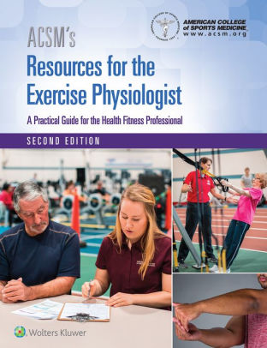

Tips for Success - Continued
Lap Top with a web camera to take computer based exams and quizzes
Workout gear – shorts, short-sleeve t-shirt, athletic shoes – for EP labs
Required Text Books - all EP classes use textbooks that are “required and testable material”
Non-programmable, Non-Scientific, 4 function calculator
#2 pencils
Might need Scantrons for exams – purchase at VSU Bookstore

Slide 63

Check VSU email Daily
All contact from VSU, Exercise Physiology, the Department, the College, your Advisor and Professors, will be sent to your VSU email account
VSU states that faculty and staff should not respond to non-VSU email accounts in matters that involve personal communication
“I didn’t get the email” will not be a valid excuse for …
Use professional business writing when emailing professors
  Subject line should be a key word/phrase that describes the purpose of the email
  Dear Dr. ---
  Writing in text message form is unacceptable – and likely to be deleted without a response by the receiver

Slide 64
Section V – Take Home - Tips for Success
Keep your eye on the prize
Allow yourself to be mentored
Stay with the pack
Take advantage of Student Success Center Workshops

Slide 65
Required Signatures / Documents / Training
REVIEW
Confidentiality Acknowledgement
Photo Release
Sequence of Courses
BSEP Policies
Handbook Verification
Forms will be available for review and signature in 1st Block BSEP classes during the first week of classes

Slide 66
Summary
Your professional career starts today – so be “professional”
Be prepared for sacrifices – including financial commitment beyond tuition and fees
Allow faculty and staff to mentor & guide you – but take responsibility for your own success
Get involved
Keep your eye on the prize
You GET to be here – embrace it!

Slide 67

Questions, Comments, Concerns, Other …
mkasper@valdosta.edu

